Slide 1
Two Capital Cities: Sacramento vs. Austin

Slide 2
The Problem
Socially and politically, there have been talks of a “mass exodus” from California to Texas
People move for financial reasons mostly, not necessarily for the sake of moving away from California
I want to see if people moving from California will be able to find places in Texas that are comparable to where they live
It is impossible to compare every single city to each other in both states wo we only choose two, Sacramento and Austin
There were chosen because they are both the capital cities of their respective states. Neither are the biggest city in their state so there is less bias in regards to size and population count

Slide 3
How we will approach the problem
First we will do a comparison of the populations of the cities and their states over the past ten years, to see if we can identify any trends
Then we will look at the types of venues in each neighborhood in each city, and create clusters of neighborhoods based on that
Next we will label each cluster and compare the clusters to get a sense of how the cities are similar and how they differ
Finally, we will make a judgement if someone moving from the capital of California would be able to find a home if they decided to move to the capital of Texas

Slide 4
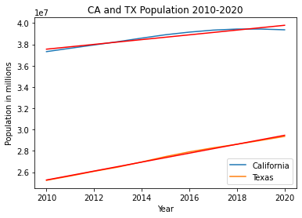
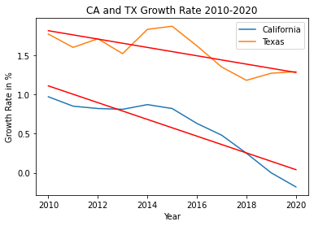
California and Texas population (data from US Census)
Population
Growth Rate
The population for both states has been increasing, with CA plateauing around 2017. The growth rate has been decreasing for CA over time, but TX’s has been on the upswing since 2018.

Slide 5
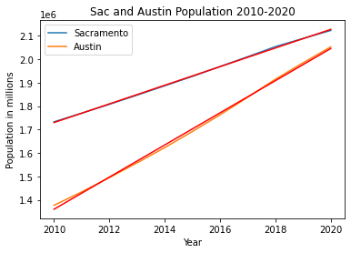
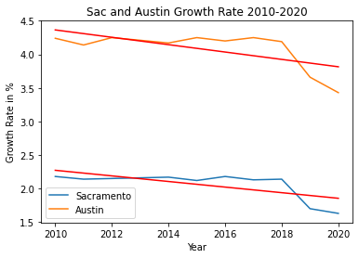
Sacramento and Austin population (data from US Census)
Population
Growth Rate
Both cities have been seeing a rapid increase in population, with Austin’s growing much faster. Interestingly, both cities had a relatively steady growth rate until 2018 where both dropped by almost a full point. Austin is bouncing back faster.

Slide 6
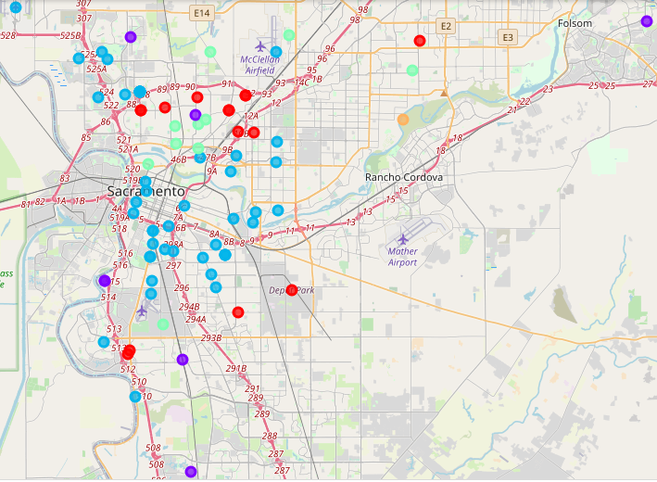
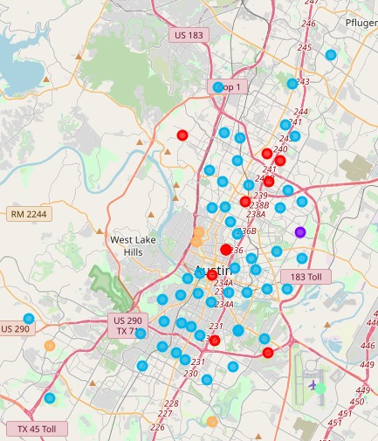
Visualization of Neighborhood Clusters
Sacramento
Austin

Slide 7
After venue analysis of both cities, we came up with five clusters for each
Sacramento | Austin
Busy Suburban | High Traffic/Tourist/Downtown
Non-Busy Suburban/Nature | No Idea
Downtown/Shopping/High Traffic | Busy Suburbs/Eating/Tourist
Busy Suburban (Mexican community?) | Airport
Outdoors | Outdoors/Suburban

Slide 8
After eliminating the outlier data, we are left with three clusters for Austin
Sacramento | Austin
Busy Suburban | High Traffic/Tourist/Downtown
Non-Busy Suburban/Nature | Busy Suburbs/Eating/Tourist
Downtown/Shopping/High Traffic | Outdoors/Suburban
Busy Suburban (Mexican community?)
Outdoors

Slide 9
Similarities between Sacramento and Austin
Both have downtown areas that are characterized by a large amount of retail shops, restaurants and fast food, and tourist attractions. The neighborhoods in those clusters are also geographically very close
Both have busy suburban areas, that also have a lot of restaurants and stores, but they also have a lot of grocery stores and parks, indicating that it is also a residential area
There are outdoor areas in both cities, meaning there are places for outdoor recreation and nature preservation, though Austin’s is connected to its suburban area

Slide 10
Difference between Sacramento and Austin
Austin lacks a cluster that is both suburban and non-busy, meaning that it has the characteristics of a suburb (park, grocery store, etc.) but not a large amount of restaurants and stores
The Outdoors/Suburban cluster is the closest to that, but the Outdoors label differentiates it as more being for outdoor activities and natural preservation
One Sacramento cluster had Mexican restaurants in almost every neighborhood, which indicated to me that there are a significant amount of neighborhoods with large Mexican communities. I could not identify a similar trend in the Austin clusters

Slide 11
Conclusion
There seem to be enough similarities that could help incentivize someone to move from Sacramento to Austin
Both have similar enough clusters that one could live similar lifestyles in both cities. Specifically, both have bustling city centers and slower suburban areas that allows people of all walks of life to feel comfortable living there
Sacramento has a more dedicated area for nature, but Austin has enough neighborhoods with parks and nature access to make up for it
Austin seems to be a busier city overall, but it has a lot of different suburbs that appeal to people of different lifestyles, whether they want a fast paced or more calm environment

